Slide 1




NEXT GEN EMPLOYABILITY PROGRAM
Creating a future-ready workforce
Team Members
College Name
Student Name : K. Dhivya
Student ID : 623521104010
6235 - AVS College of Technology

Slide 2

CAPSTONE PROJECT SHOWCASE
Project Title
Building Bus Reservation System using Python and Django
Abstract | Problem Statement | Project Overview | Proposed Solution | Technology Used | Modelling & Results | Conclusion

Slide 3
Abstract
The Bus Reservation System (BRS) is a web-based application developed using Python and Django framework.
Aimed at facilitating the booking and management of bus tickets, providing convenience and efficiency to users.
Key features include user registration/authentication, bus and route management, seat reservation, payment integration, and reservation management.
Users can create accounts, log in securely, and search for available buses based on route, date, and time.
Source :

Slide 4
Problem Statement
Integration with payment gateways is often unreliable, resulting in payment failures and frustration for users.
Reservation management features are inadequate, leading to overbooking, conflicts, and customer dissatisfaction.
Administrative tools for managing buses, routes, and bookings are insufficient, causing inefficiencies and missed optimization opportunities.
In response to these challenges, there is a need for a modern, user-friendly, and efficient bus reservation system
Source :

Slide 5
Project Overview
The Bus Reservation System (BRS) is a web-based application developed using Python and Django framework, aiming to streamline the booking process and enhance the management of bus reservations. Here's an overview of the project:
Objective: The primary goal of the project is to create a user-friendly and efficient platform for booking bus tickets, providing accurate information to passengers, and empowering bus operators with effective management tools.
Source :

Slide 6
Proposed Solution
Develop a comprehensive Bus Reservation System (BRS) using Python and Django framework to streamline the booking process and enhance reservation management.
Key Components:
User Management
Bus and Route Management
Seat Reservation
Payment Integration
Source :

Slide 7
Development Process:
Develop a dedicated mobile application for bus ticket booking.
Integrate real-time updates for bus schedules and seat availability.
Enhance the admin dashboard with advanced analytics tools.
Implement dynamic pricing algorithms based on demand.
Enable support for multiple languages.
Source :

Slide 8


Technology Used
Front-end
Back-end
Source :

Slide 9
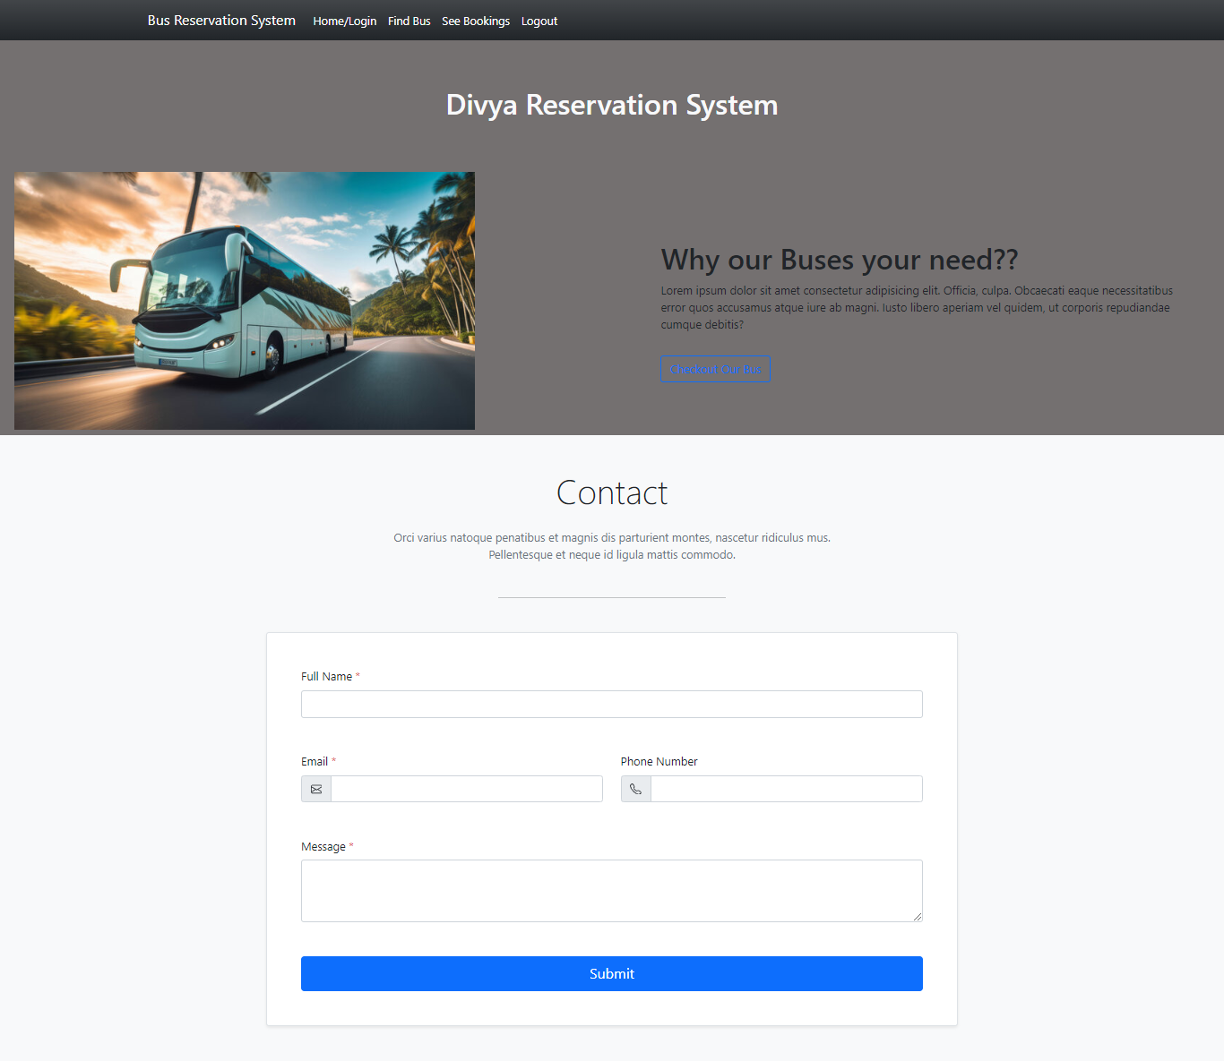
Modelling & Results
Source :

Slide 10
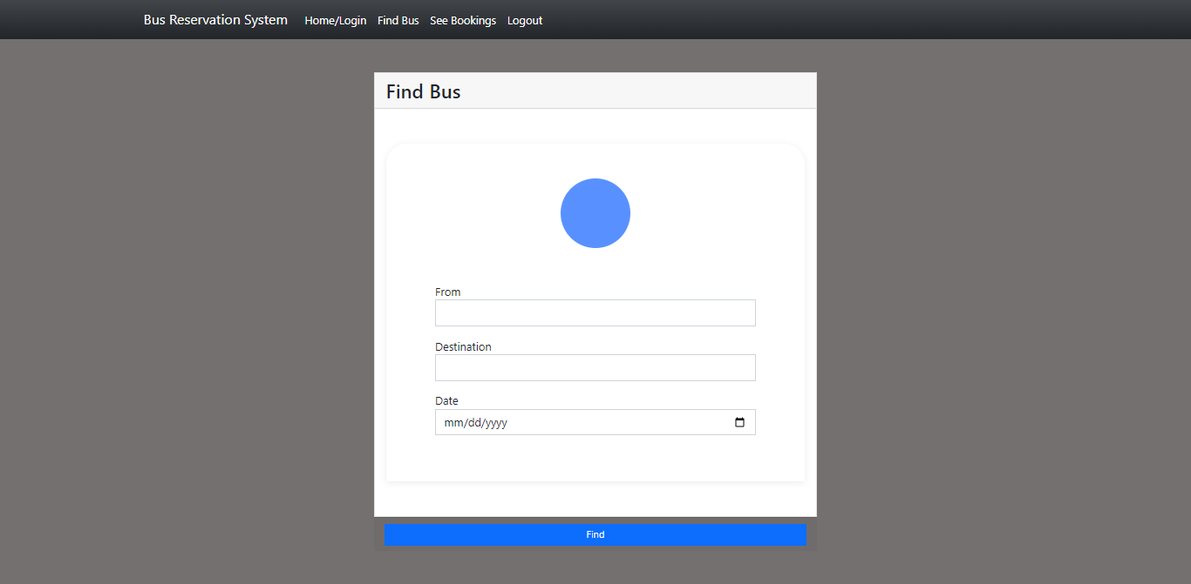
FIND BUS

Slide 11
HOME PAGE

Slide 12
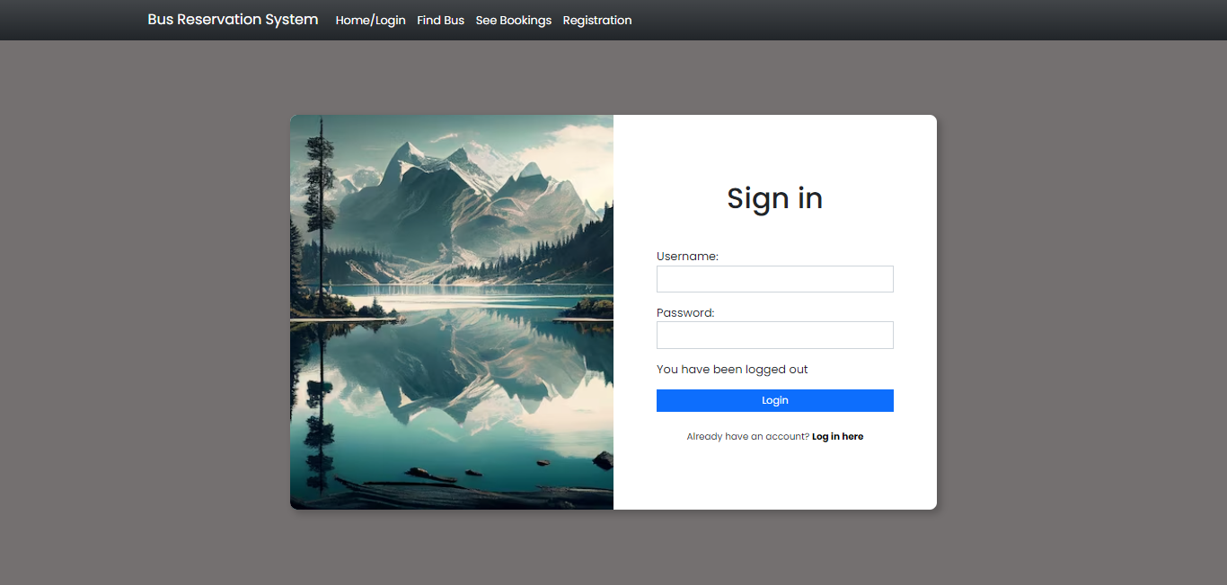
LOGIN PAGE

Slide 13
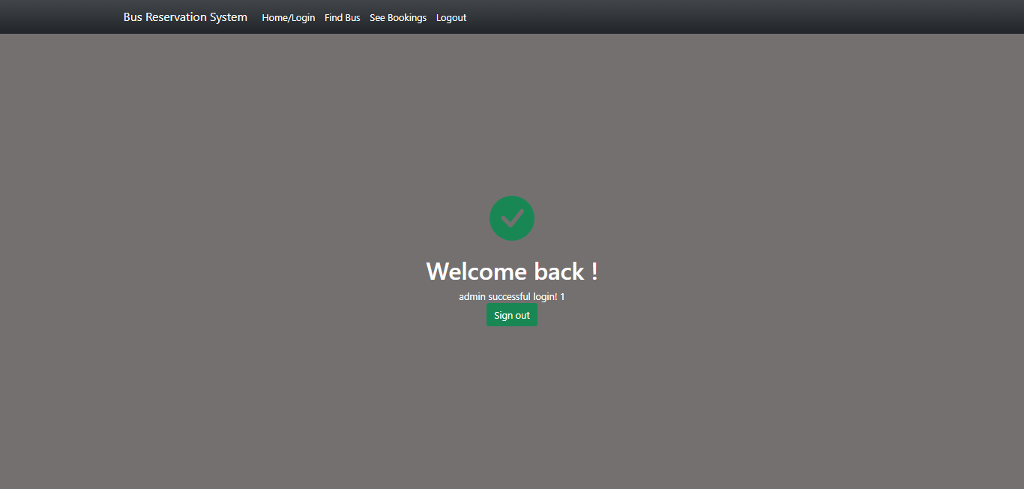
THANKS PAGE

Slide 14
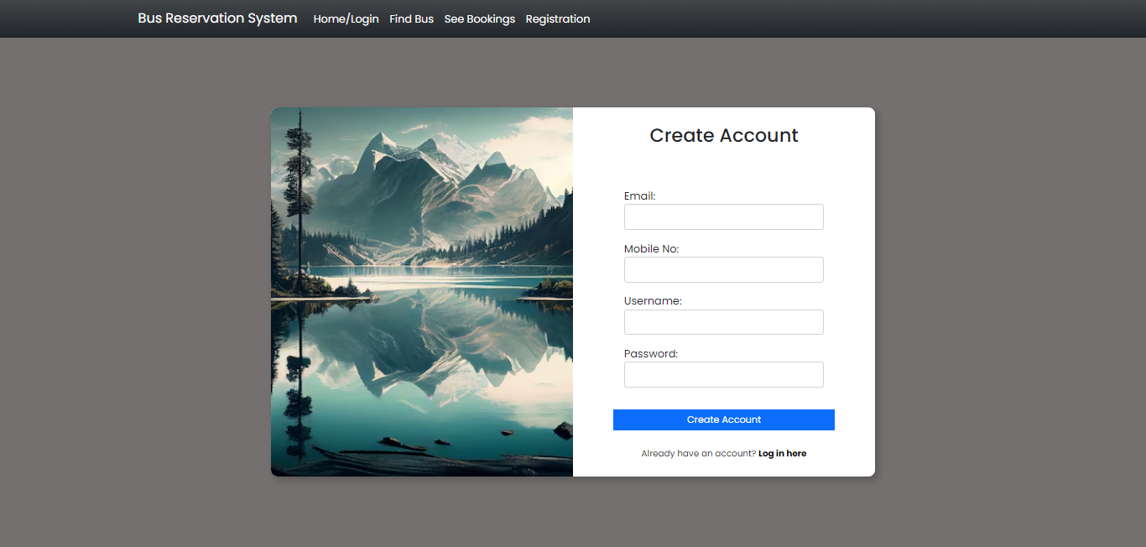
REGISTRATION PAGE

Slide 15
Future Enhancements:
Allow users to share bookings on social media platforms.
Integrate with other transportation modes for seamless travel.
Implement a feedback system for users to provide reviews.
Enhance accessibility features for users with disabilities.
Introduce QR code or RFID-based ticketing systems.
Promote environmental initiatives for sustainable travel.
Implement IoT sensors for predictive maintenance.

Slide 16
Conclusion
By leveraging Python and Django framework, the system streamlines the booking process, enhances reservation management, and provides a seamless experience for both passengers and bus operators.
With key features such as user authentication, bus and route management, seat reservation, payment integration, and admin dashboard, the BRS caters to the diverse needs of users while empowering administrators with effective tools for bus management and analytics.
Source :

Slide 17
Thank You!
Notes:
Thank You !!

